Slide 1


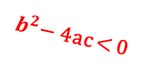



$b^{2}$− 4ac = 0
$$P_{1}$$
Ray 1 – intersects at 1 point
r
O
D
M
L
r
d
r
Ray 2 – intersects at 2 points
G
$b^{2}$− 4ac > 0
$$P_{1}$$
$$P_{2}$$
Ray 3 – does not intersect
$b^{2}$− 4ac < 0

Slide 2












$$−1$$
$$Screen$$
$$extended$$
$$− 0.4$$
$$Screen view$$
$$640×256$$
$$0$$
$$y$$
$$0.4$$
$$Screen$$
$$extended$$
$$1$$
$$−1$$
$$0$$
$$1$$
$$x$$

Slide 3
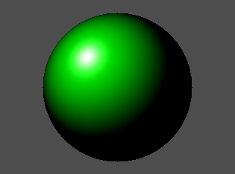
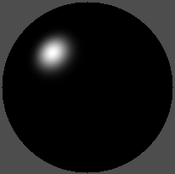




$$Ambient$$
$$Diffuse$$
$$Specular$$
$Combined$ $(Blinn−Phong)$

Slide 4

S
45°
90°
S
0°
N
N

Slide 5

S
H
N
$$P$$
E
R

Slide 6
y
0
1
2
3
4
0
1
X
2
3

